Slide 1
MFA Update

Slide 2
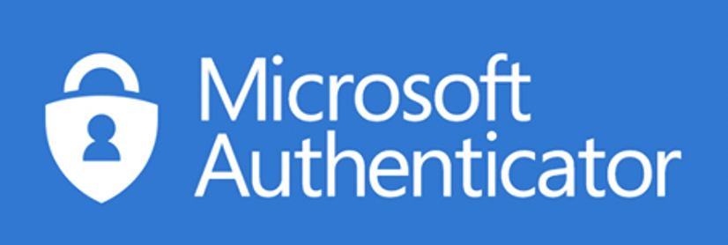
Multifactor Authentication
What is Multifactor Authentication (MFA)?
MFA adds a second layer of protection to your sign-in process. This method validates your identity and tells our systems you are who you are supposed to be and not some hacker.
The Why..
Common vulnerabilities for businesses include
Email compromise – phishing, spoofing
Legacy authentication protocols – older apps
Password reuse – reusing your password for
MFA can block over 99.9% percent of account compromised attacks!

Slide 3
Multifactor Authentication
What services does MFA protect?
Microsoft 365 services
Email
Will it replace Duo or OneTime passcode for sites such as HRCentral, Kronos, Bridge?? - Yes, in the future we will work to consolidate all services to use Microsoft Authenticator.
Email | External Citrix - Epic Access
OneDrive | Successfactors (coming soon)
Microsoft Teams | Paystubs (coming soon)
SharePoint | Replacing Duo – F5 VPN Edge Client
OneNote | HRCentral (future)
Microsoft 365 Services

Slide 4
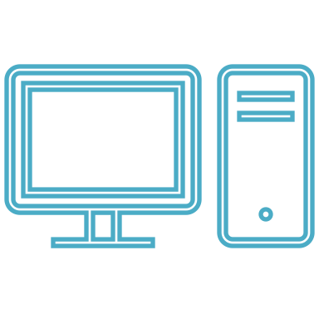
Multifactor Authentication
No MFA needed
MFA required
TRUSTED DEVICES
on corporate network or VPN
UNTRUSTED DEVICES
NO MFA is needed for Trusted devices on the corporate network or VPN.
TriHealth desktop or laptop
TriHealth shared workstation
TriHealth VDI/Citrix
Personal device with app protection
MFA is required for untrusted devices.
Home computers
Access to email from hotel terminal
Personal device not using Microsoft Mobile apps such as Outlook.

Slide 5
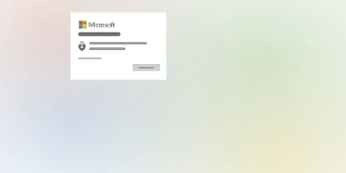
What You Have, What You Know
What do I need to use Microsoft Authenticator?
You’ll need to use your smart phone - iOS or Android.
You’ll need to register for Microsoft Authenticator.

